Slide 1
PASS Poster Slides for GRC Poster Event
Arunabho Basu
Florida Institute of Cybersecurity Research Electrical and Computer Engineering Department

Slide 2
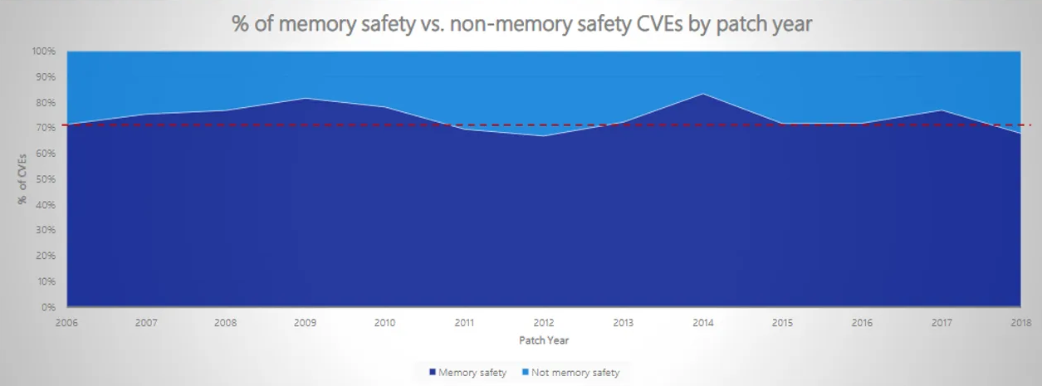
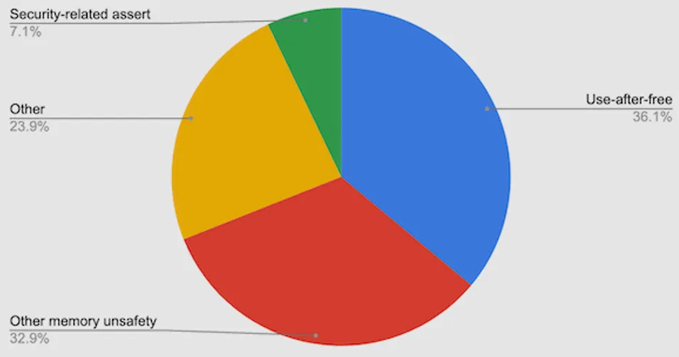
Motivation and Background
Vulnerabilities
C/C++ codes are susceptible to memory safety and control flow violations
Software developers/compilers are not informed of physical attacks which can bypass upper-level security measures (like Fault Injection Attacks)
Compiler Hardening
Existing compiler hardening techniques address software level vulnerabilities by setting security flags in compiler
They fail to address physical attack vulnerabilities because much of physical attributes are abstracted at software level
Our solution :
Adding physical hardening measures to compiler so compiled code is physically-aware of underlying vulnerabilities
Microsoft says around 70% of security updates address memory safety vulnerabilities in their products
Google says upto 70% of security issues in Google Chrome are related to memory safety.
Notes:
Memory safety related vulnerabilities form the bulk of security issues in popular softwares. The standard compilers can harden against software level vulnerabilities but cannot address physical level vulnerabilities.
Existing efforts have tried to predict it using observable characteristics from the upper level. Most physical characteristics are not observable from the upper level because of abstraction and thus these upper-level predictions are unrealistic and ineffective.
Integrating physical attack hardening to compiler enables code to be compiled in physically aware fashion. So physical attack vulnerabilities discovered post silicon can be addressed without expensive call-outs and rollbacks.

Slide 3
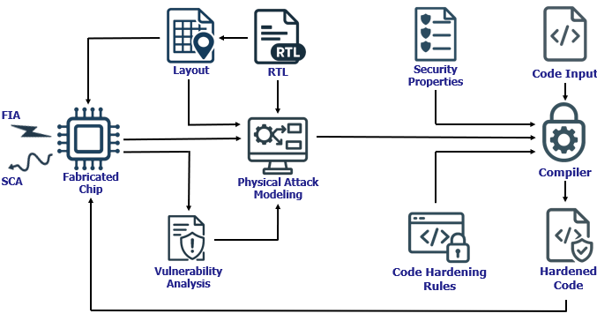
Proposed Solution Workflow – Physical Hardening at Compilation
Objectives
Effective Modeling of Physical Vulnerabilities to make the compiler Physically-Aware
To implement and demonstrate Physical Hardening during compilation against Physical Attacks
Highlights of our proposed workflow
Fast and Powerful : Addressing physical threats during code compilation is fast and powerful because compiler links the hardware and software
Scalable and Cost effective : When physical vulnerabilities are discovered post-silicon stage, their hardening can be added to our framework, saving expensive chip callbacks
Secure Coding : Our physical models also inform software developers about underlying vulnerabilities in hardware
Workflow for Hardening Software against Physical Attacks during compilation
Notes:
Our work aims to develop a hardened compiler that can take a high level non hardened code and compile it into physically hardened machine level code. The compilation stage is perfect for implementing this hardening bc the software is linked to underlying hardware during this stage.
First major step is physical modelling of the attacks. So we take the layout level information of a fabricated chip and simulate physical attacks on it.
Once we have modeled the attack we implement security properties and corresponding hardening techniques. These hardening techniques are applied during compilation, so we get a physically hardened machine code.
Lastly, its important we evaluate our hardening by running the hardened code on the same chip and analyzing how much improvement we are seeing and in which areas.

Slide 4
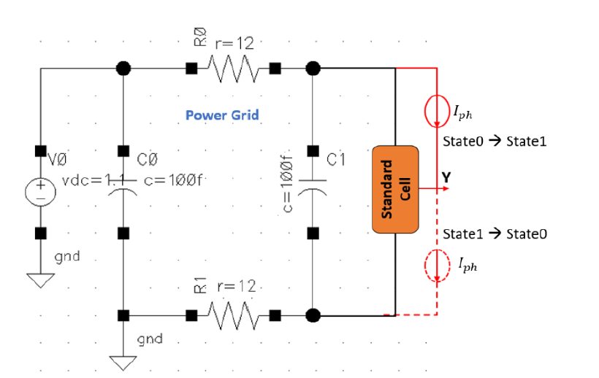
Modelling Laser Fault Injection using SPICE
Physical impact of laser can be modeled as extra current sources in SPICE simulations.
The Laser Fault Injection (LFI) is simulated by the SPICE circuit shown in adjoining figure.
Every standard cell is simulated for LFI when in State0 and State1, and the currents on VDD and VSS rails are captured for both states.
These currents on power rails during laser illumination are recorded for all the standard cells in the library
SPICE model simulating Standard Cell under Laser Fault Injection
Captured current demands across power rails for simulation of Inverter Cell under LFI
Notes:
Experimental Setup :
Design Under Test : RISCV soft core
Fault simulation tool : Synopsys Z01X is used to simulate pre-silicon fault-injection attacks
Hardening techniques developed on top of the RISCV-GCC compiler toolchain in Ubuntu 22.04 LTS
Cadence Spectre is used for SPICE simulations
Cadence 45 nm standard cell library is used for physical modelling of cells
To simulate the behavior of standard cells under laser illumination, we constructed a SPICE circuit. , as shown. This setup provided a simplified yet effective means of analyzing the impact of laser fault injection on complex standard cells. Every standard cell is simulated for laser illumination when in State0 and State1, and the currents on VDD and VSS rails are captured for both states. These currents on power rails during laser illumination are recorded for all the
standard cells in the library. Fig on right shows the current profiles at the VDD rail for the inverter’s two states (i.e., LFI State0 and LFI State1) when at the center of the 2W laser spot

Slide 5
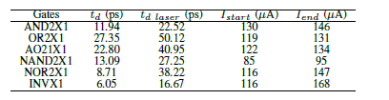
Impact of LFI on Physical Characteristics
Impact of LFI on delay in Standard Cells
In this table, we present two physical characteristics of the standard cells involved in implementation of our test program with sensitive branches:
The delay observed at output for high to low transition with and without laser fault injection,
The laser induced current before and after signal distortion
Takeaways
The table shows that some cells are more vulnerable than others.
Adjoining figure shows that scaling the Laser Intensity also increases the delay since laser induced current slows down voltage transition.
Output delay variations and laser current values
when signal distortions start and end.
Delay and voltage responses on AND2X1 standard cell when scaling the laser-induced current.
Notes:
It is observed that, the delay of critical gates increases significantly under attack.
For example, in case of AND2X1 gate, delay increases from 11.94 ps to 22.52 ps under laser-induced current.
For INVX1 gate, laser-induced faults become significant at 116 µA to 168 µA. These results highlight that certain cells are more vulnerable than others.
How this impacts the software compilation process:
The results are fed into the compiler to help determine where fault-hardened code transformations should be applied based on the feasibility and criticality analysis we did before.
This ensures that critical computations are protected without costly hardware redesign.

Slide 6
Compiler Hardening Example – Branch Hardening
If the branch condition is bypassed/modified by a Fault Injection the attacker gets access to the security asset in the fall-through branch.
We harden this by re-implementing same logic using different instructions such that security asset is not in the fall-through branch.
Similarly other hardening rules can be implemented and added to the compiler, including the existing hardening standards.
Thus, we create a Security Rule Database based on Physical Modeling and Fault Simulations.
Source code in C
Compile with GCC-RISCV
Harden
Assembly code compiled with built-in security flags
Hardened code from our proposed flow
Impact of with hardening :
Faults modifying/bypassing the conditional jump will now directly lead to a password-checking failure
Notes:
An example of a hardening rule –
branch hardening : if my compiled assembly code stores security asset in default branch, branch condition can be easily skipped by a fault injection and attacker will get access to security asset;
this can be hardened by storing the security asset in a branch that requires a jump. So skipping branch condition will not give access to security asset.
Other similar hardening rules to be added to our compiler, in addition to existing hardening rules.

Slide 7

Summary and Future Work
Summary
We proposed a novel hardening flow that allows to address Fault Injection Vulnerabilities at the software compilation stage.
Our approach models Fault-Injection Attacks based on physical design characteristics, facilitating secure software compilations with low-cost and effective physically-aware hardening techniques.
We demonstrated that a critical conditional branch in a password-checking application could be protected against laser fault-injection attacks by reorganizing the assembly instructions during the compilation stage.
Future Work
Improve the precision of our current modeling of Laser Fault Injection
Model other categories of physical attacks such as clock/voltage glitching and side-channel attacks
Extend the hardening database for this physically-aware compiler.
Notes:
We proposed a novel hardening flow that models Fault-Injection Attacks based on physical design characteristics, and incorporates this information during compilation stage hardening, facilitating secure software compilations with low-cost and effective physically-aware hardening techniques.
Our scope of future work involves scaling the current approach to model more physical attacks, improving the model precision and scaling the hardening rules database.

